Slide 1
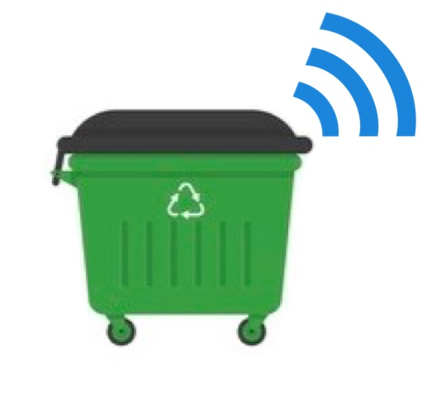
BIDONCINI
DE RISI SIMONA, ZERPA RUIZ JOSEF EMANUELE

Slide 2
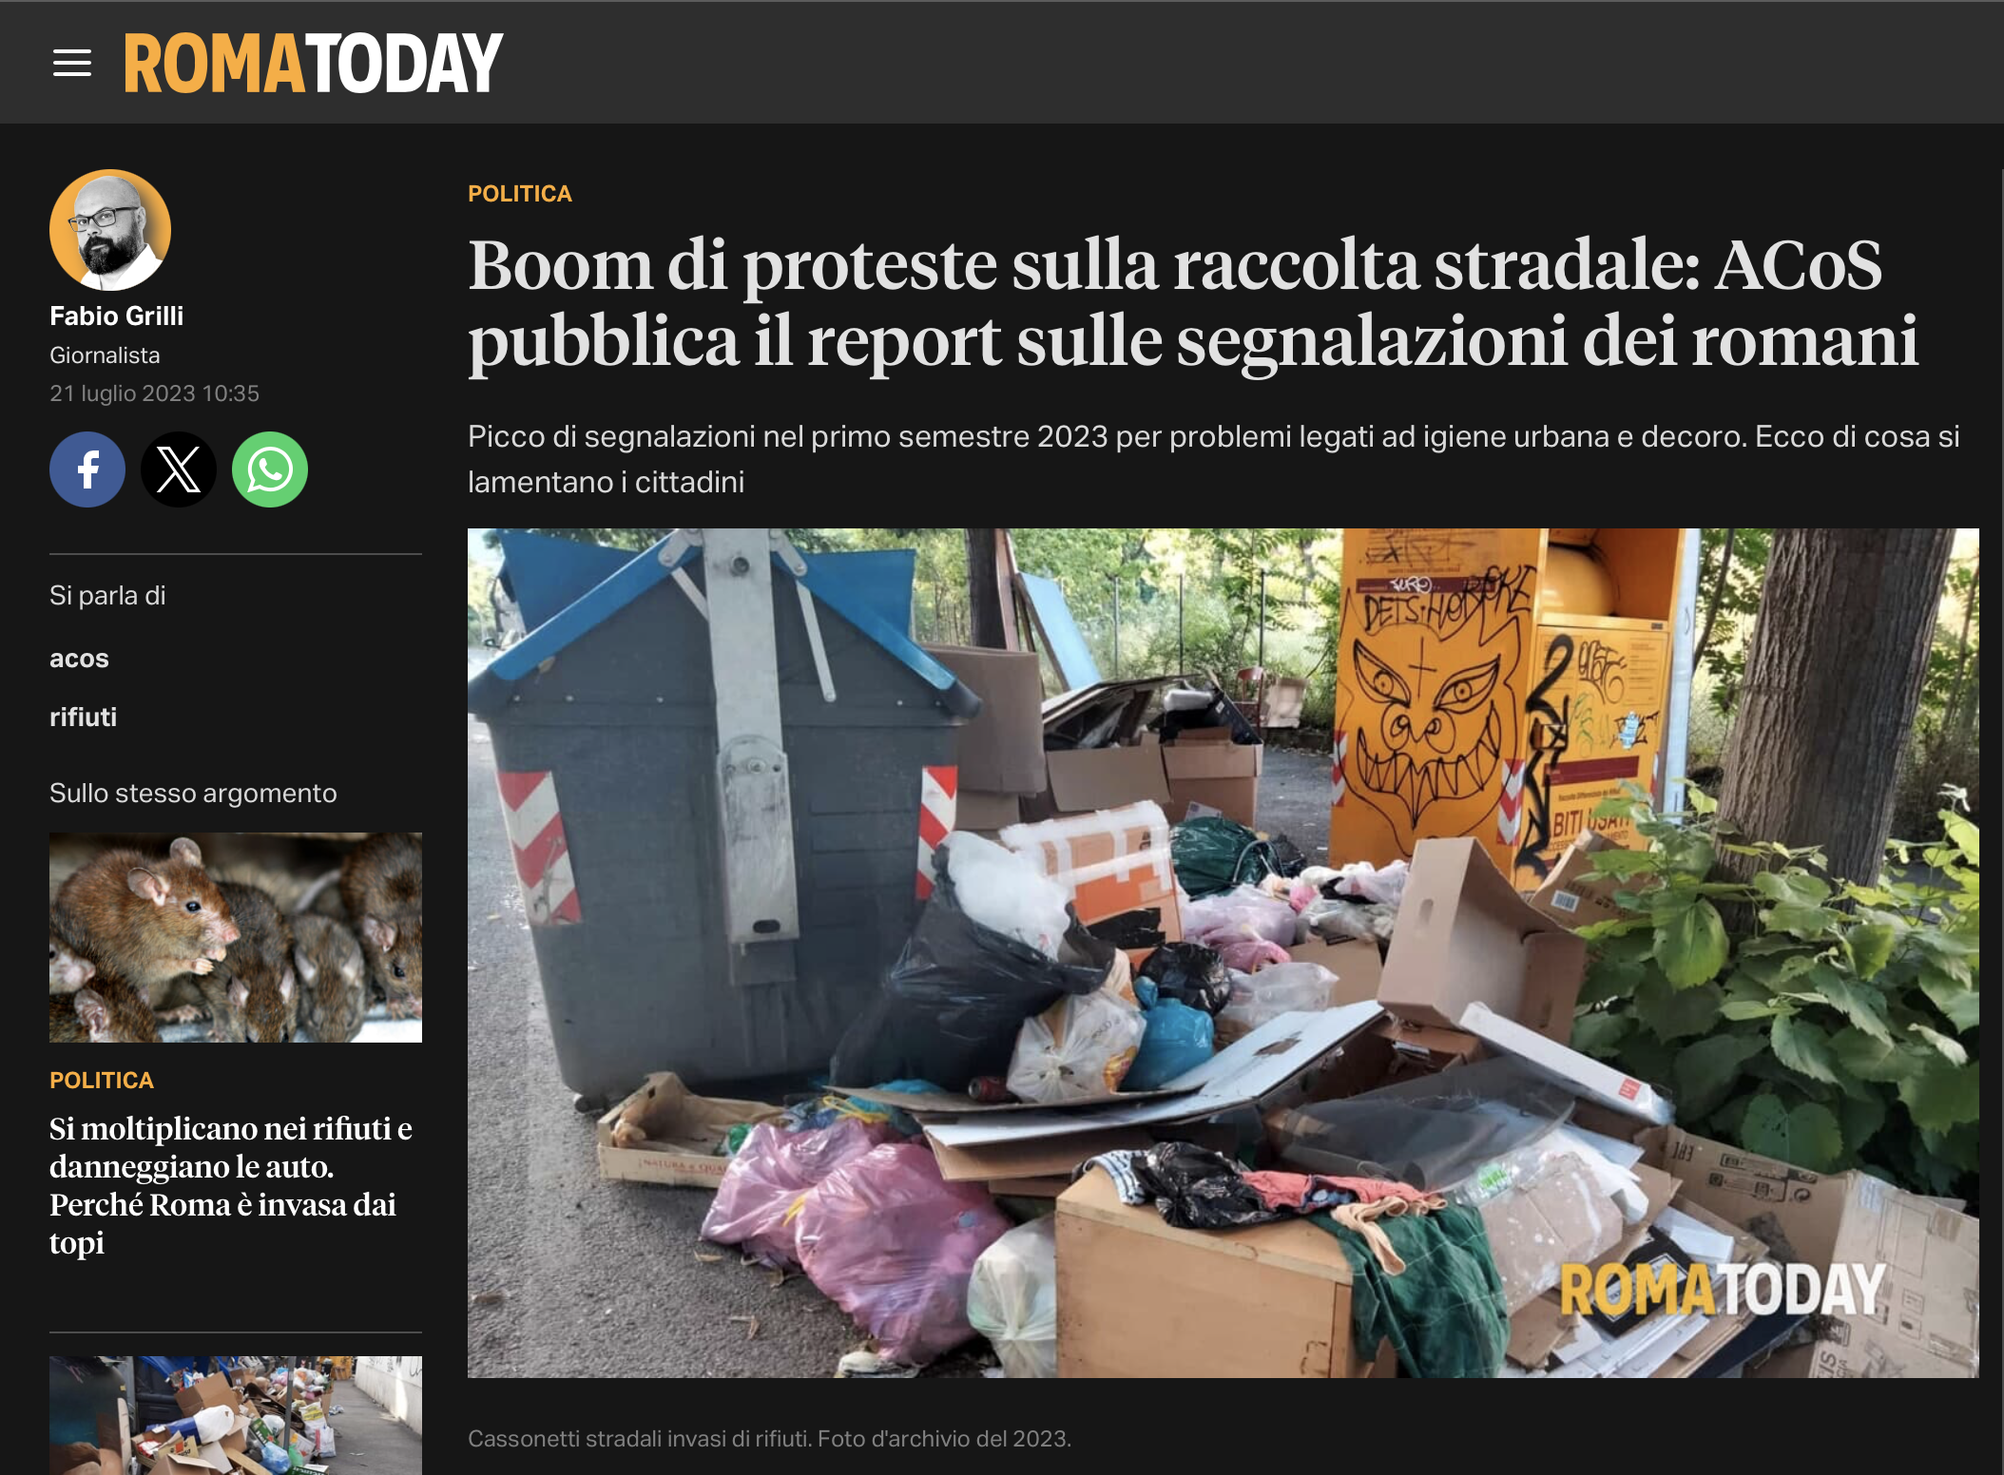
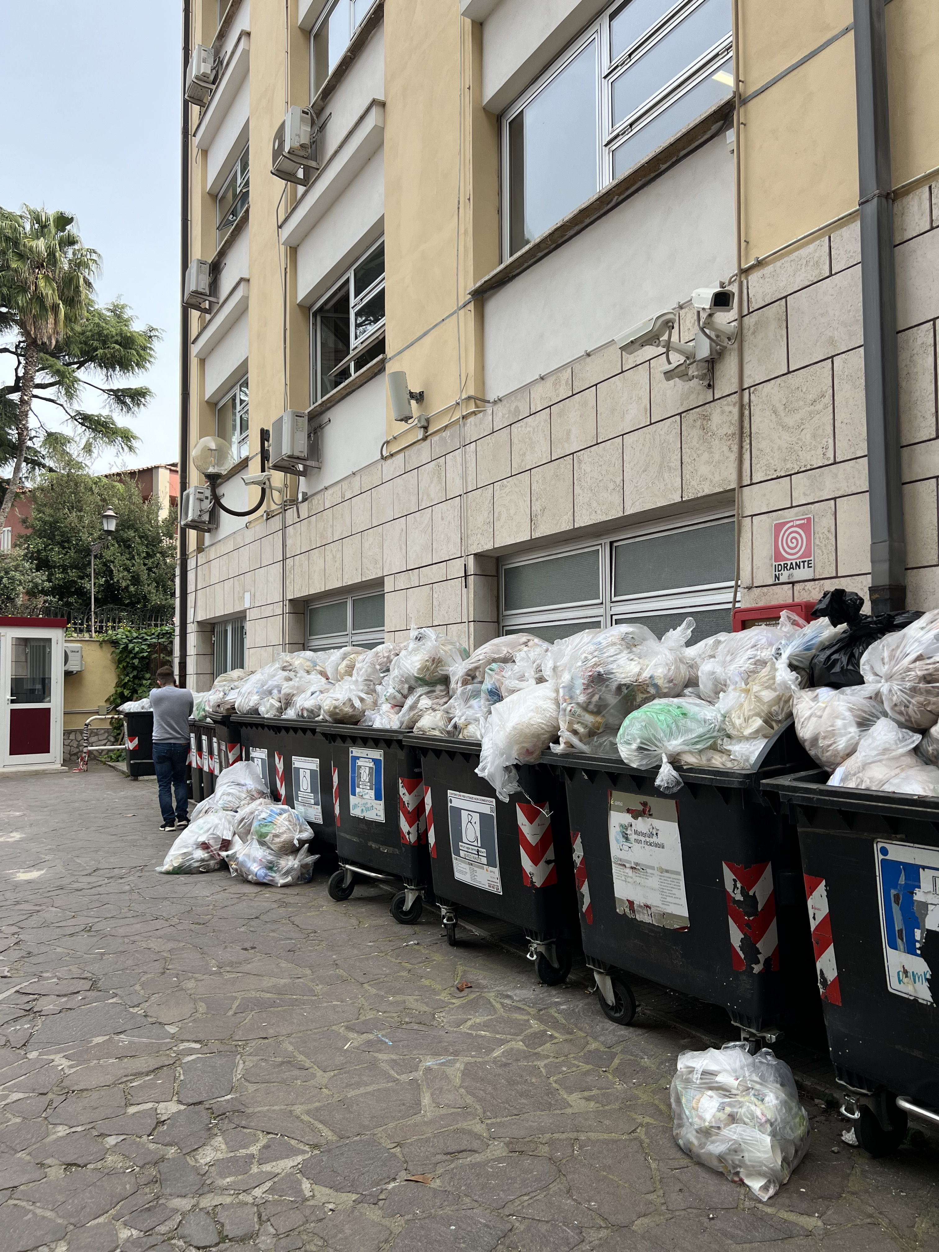
The problem
Rome is a city home to 2.8 million residents, hosting 7-10 million tourists each year (source: Wikipedia). Litter is a big problem, especially during hot seasons.
Our project aims to tackle this phenomenon, by bringing smart IoT devices to record and analyze trash production.

Slide 3
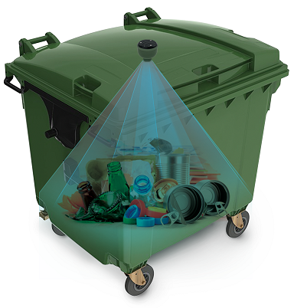
The solution
An IOT device would provide us with a cheap but extensive solution. A distance sensor would tell us when a dumpster is full.
Frequency analysis would tell us the optimal trash collection frequency. Statistical analysis on the whole network would instead indicate us more active areas, useful to consider dumpster reallocation.

Slide 4
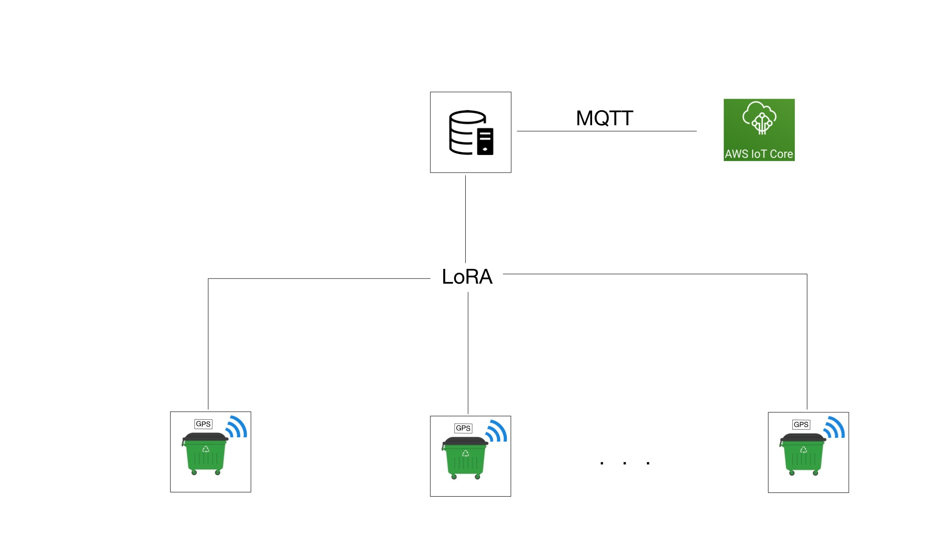
IOt architecture
LoRA to transmit data to the gateway.
MQTT to forward to the cloud.
Notification

Slide 5
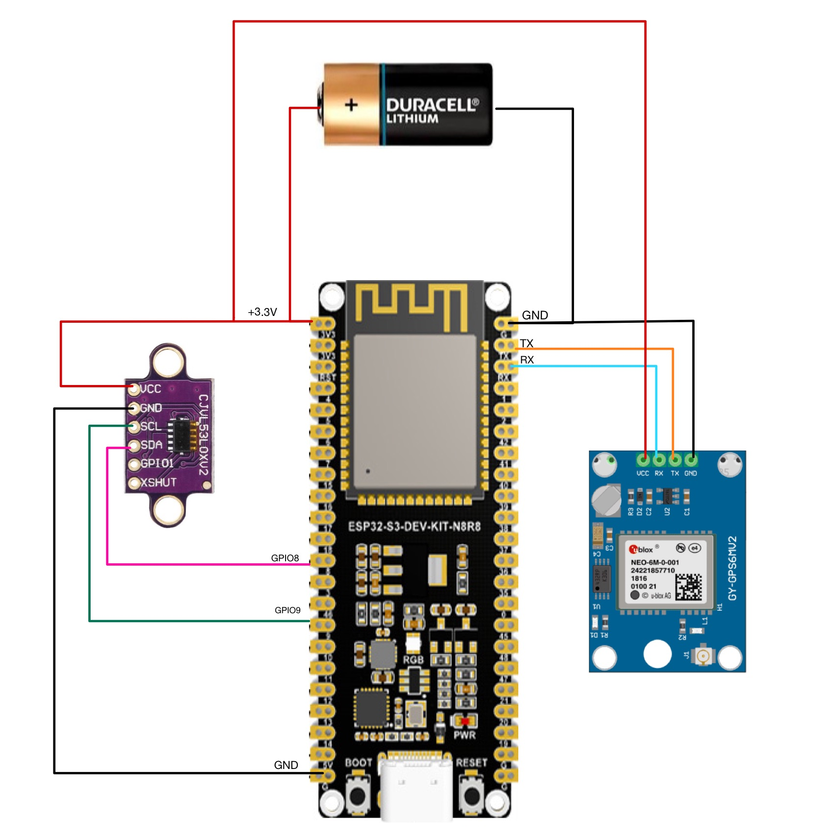
Device components
ESP32 board
Distance sensor
GPS module
Battery

Slide 6
Data collected
Trash production, most active areas.
Actuators
Notification of trash collection, collection performed by operators.
Impact on the environment
Optimization of trash collection routes, reduction of overflowing dumpsters.

Slide 7
Constraints
Bandwidth: relevant, but addressable with gateway replication. Also packet size minimal.
Latency: not relevant.
Energy: expected low power consumption.
Duty cycle: measurement and value forwarding. Periodical frequency analysis.
Frequency: adjusted to frequency analysis.

Slide 8
Performance evaluation
Bandwidth: 4 byte packet size.
Latency: to be measured.
Energy: distance sensor: 6 uA on sleep, 19 mA on duty.
gps sensor: 47 mA on duty.
Duty cycle: to be measured.

Slide 9
Measure effectiveness
STEP 1: Install the devices and collect data (no action).
STEP 2: Activate notification system.
STEP 3: Compare data.

Slide 10
THANK YOU
De Risi Simona
Zerpa Ruiz Josef Emanuele

